Slide 1
Poetry in South Africa
Soweto POETRY and Beyond
[During and after Apartheid]

Slide 2
Poetry assignment
Form groups of 3- or 4
Each person will be given slips of paper containing one to three lines from a poem.
You must try to reassemble the poem as a group
Initially you may not show your cards to anyone,
& instead you must read the lines aloud.
You will have 5-8 minutes to try to assemble the poem.
Then we will compare notes with all the other groups.

Slide 3
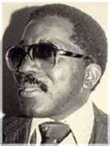
Always a Suspect
By Oswald Mbuyiseni Mitshali
I get up in the morning
and dress up like a gentleman –
A white shirt a tie and a suit.
I walk into the street
to be met by a man
who tells me to ‘produce’.
I show him
the document of my existence
to be scrutinized and given the nod.
Then I enter the foyer of a building
to have my way barred by a commissionaire
‘What do you want?’
I trudge the city pavements
side by side with ‘madam’
who shifts her handbag
from my side to the other,
and looks at me with eyes that say
‘Ha! Ha! I know who you are;
beneath those fine clothes
ticks the heart of a thief.’

Slide 4
Poetry assignment continued
Discussion
Was it easy or difficult to assemble the poem ?
How did you determine the order of the lines ?
What meanings do you think the poem conveys?

Slide 5
Themes & style of poetry
“Always a Suspect” first published in 1971
Addresses the day to day life in the townships
Intention and social critique is slightly veiled, stated in code
Indirectly challenges the social inequalities in South Africa
Depicts the ironies of what typically would symbolize a respectable character
“A White shirt and tie and suit “ and places that in direct contradiction with the thoughts and behaviors imposed unto blacks during the Apartheid era.

Slide 6
The intellectual and literary background to Soweto poetry- 1970s
Soweto poetry emphasized a radically altered sense of reality after the devastating events from the Sharpeville Massacre.
The Sharpeville Massacre, which occurred on March 21, 1960, in the township of Sharpeville, South Africa,
There were 249 casualties in total, including 29 children. Many sustained back injuries from being shot as they fled
This event resulted in what was then the largest number deaths in a protest against apartheid.
It came to symbolize the struggle for black south Africans.
PBS Independent lens: Have You Heard from Johannesburg: The Sharpeville Massacre (Clip: Season 13 Episode 8 | 1m 49s)
https://www.pbs.org/video/independent-lens-the-sharpesville-massacre-catalyzes-a-movement/
Sharpeville massacre was turning point in anti-apartheid movement - CBS
https://www.youtube.com/watch?v=n2EvZ8cYcC8

Slide 7
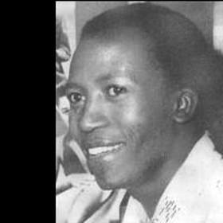
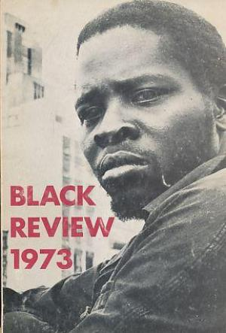
Soweto poetry or Township poetry
Other poets in this genre of poetry
Casey Motsisi,
Poets were concerned with the realities of survival; they wrote what is known as Soweto poetry. Soweto was a Bantu suburb of the city, Johannesburg.
Soweto itself stands as the metaphor of the then identified post-Sharpeville mood.
(sometimes called Township poetry, or The New Black poetry of the 1970s, Participatory poetry, People’s poetry.)
Mafika Gwala
Notes:
Chapman, Michael. South African Literatures. http://www.michaelchapman.co.za/index.php?option

Slide 8
Soweto poetry
Soweto poetry was distinct due to its hidden to more gradually direct confrontation with racism
while the immediate symbols of oppression come from everyday life (bulldozers razing shacks, for example, and so dictating mechanical policies of ‘resettlement')
a township of wrecked cars, hovels, scavenging dogs and siren screams.

Slide 9
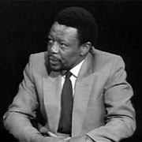
From a collection of poems
No Baby Must Weep by Mongane Wally Serote
i am the man you will never defeat
i will be the one to plague you
your children are cursed
if you walk this earth,
where i too walk
and you tear my clothes
and reach for my flesh
and you tear my flesh to reach my blood
and you spill my blood to reach my bones
and you smash my bones and hope for my soul
i am the man you will never defeat
i will be your shadow, to be with you always
and one day
when the sun rises
the shadows will move.

Slide 10
Using African oral techniques
Repetition
Parallelism
message of consciousness-raising and race pride
Poems Intended for a black communal audience
i am the man you will never defeat
i will be the one to plague you
…

Slide 11
Poets after the apartheid regime
Female poet, Malika Ndlovu (born in 1971)

Slide 12
“Through” by Malika Ndlovu
Ndlovu, woman poet in south Africa speaks of a place that she must journey to in order to receive joy and release
she also speaks of an inner struggle of anger and sadness due to the years of apartheid
“a place of rage, a place of mourning within to which I must go, cross the valley of fear”

Slide 13
“Through” by Malika Ndlovu
South Africa was full of hatred, sadness, and torture, but to
“cross the valley of fear” there was in the near future, as she visualized and expressed in her poem, it is also a place of joy and release.
Born into Africa

Slide 14
African Women Discuss Peace
Malika Ndlovu, Poet, opening event, African Women discuss Peace: A necessity in our time.
6:00 mins. http://www.youtube.com/watch?v=ywyNPc_Ta_c
closing ceremony
http://www.youtube.com/watch?v=SU0h6ddz6Oo
Notes:
http://malikandlovu.wordpress.com/

Slide 15
Sources
Attridge, Derek and Rosemary Jolly, eds. 1998. Writing in South Africa: Literature, apartheid and democracy, 1970-1995. Cambridge, UK: Cambridge UP.
Aolayan, Funso. 2004. Culture and Customs of South Africa. Westport, CT: Greenwood Press, 36.
Chapman, Michael. South African Literatures. http://www.michaelchapman.co.za/index.php?option.

Slide 16
Sources
Nowak, Dr. Helge and Dr. Horst Zander, eds. “Born in Africa but…”. Women’s Poetry of post-Apartheid South Africa in English. 2009. http://edoc.ub.unimuenchen.de/10368/1/Vogt_Isabelle.pdf.
"Ethnic Groups." South Africa. N.p., n.d. Web. 5 Dec 2011. http://www.jyu.fi/viesti/verkkotuotanto/kp/sa/peop_ethnicgrps.shtml.
Jordan, June. "Poem for South African Women." By June (2005): n.pag. June Jordan. Web. 5 Dec 2011. http://www.junejordan.net/poem-for-south-african-women.html.

